Slide 1


Slide 2
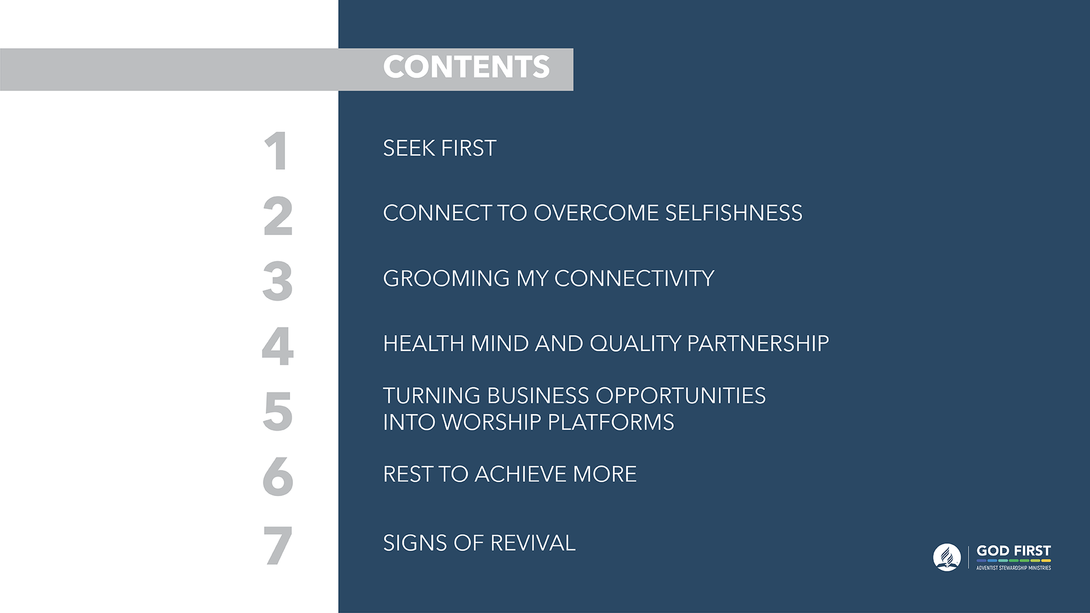

Slide 3

For the past three years “God First” has been the rallying slogan of Adventist Stewardship Ministries. This theme aligns with the revival emphasis of the world church, and it focuses mainly on the reformation component.
As we near Jesus’ second coming, we are invited to take seriously these words of the apostle Paul, “Examine yourselves to see whether you are in the faith; test yourselves. Do you not realize that Christ Jesus is in you—un- less, of course, you fail the test?” (2 Cor. 13:5). The primary aim of the 2019 Stewardship Revival Week is to reflect on our Christian journey and see how the God First message has permeated the key areas of our existence.

Slide 4


Slide 5
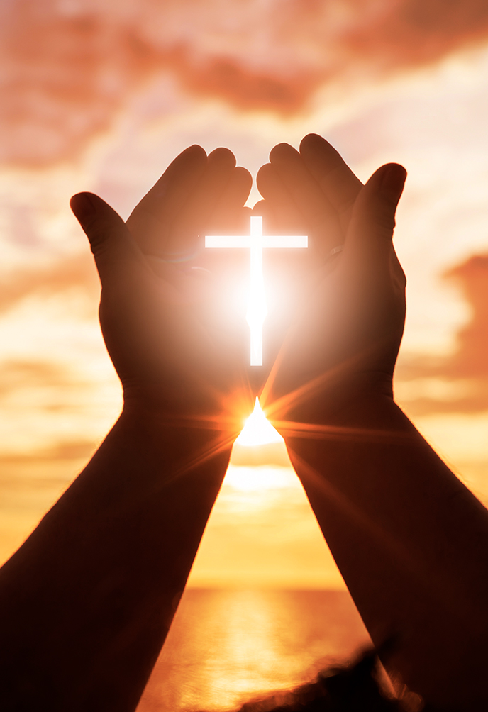
PART I
WHY SHOULD
WE PUT GOD FIRST?
DAY 1

Slide 6

PART II
WHO IS THE GOD
TO PUT FIRST?
DAY 1

Slide 7


Slide 8
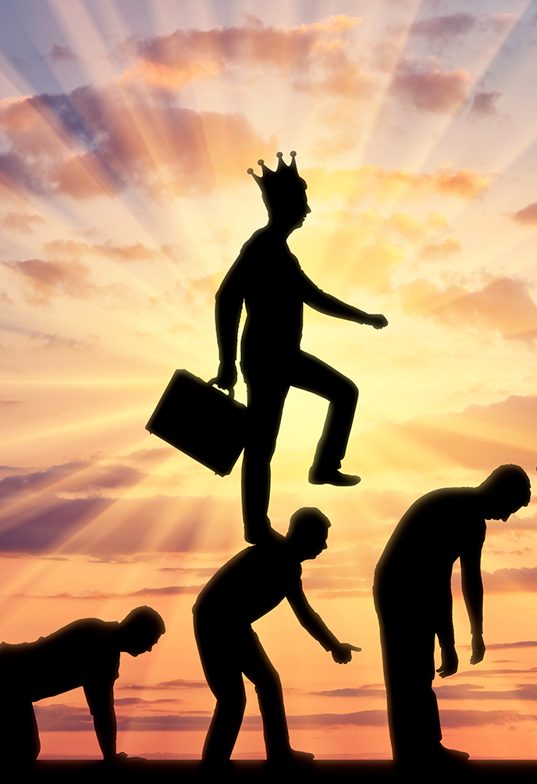
PART I
The Issue of
Selfishness
DAY 2

Slide 9

PART II
A Garden Where
Faithfulness Grows
DAY 2

Slide 10


Slide 11

PART I
The Relationship
Between Humanity
and God
DAY 3

Slide 12

PART II
Reconstruction
of Connectivity
DAY 3

Slide 13


Slide 14

PART I
The Value of
Intellectual Power
DAY 4

Slide 15

PART II
An Empowered Mind
DAY 4

Slide 16


Slide 17
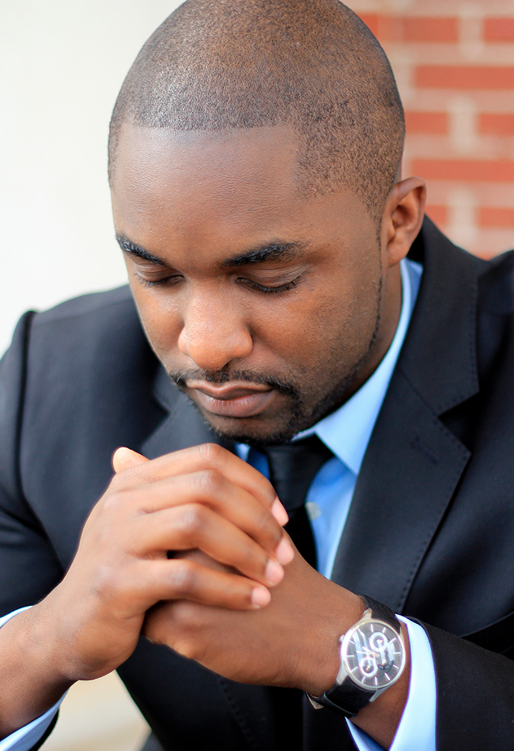
PART I
Paul the Tentmaker
DAY 5

Slide 18
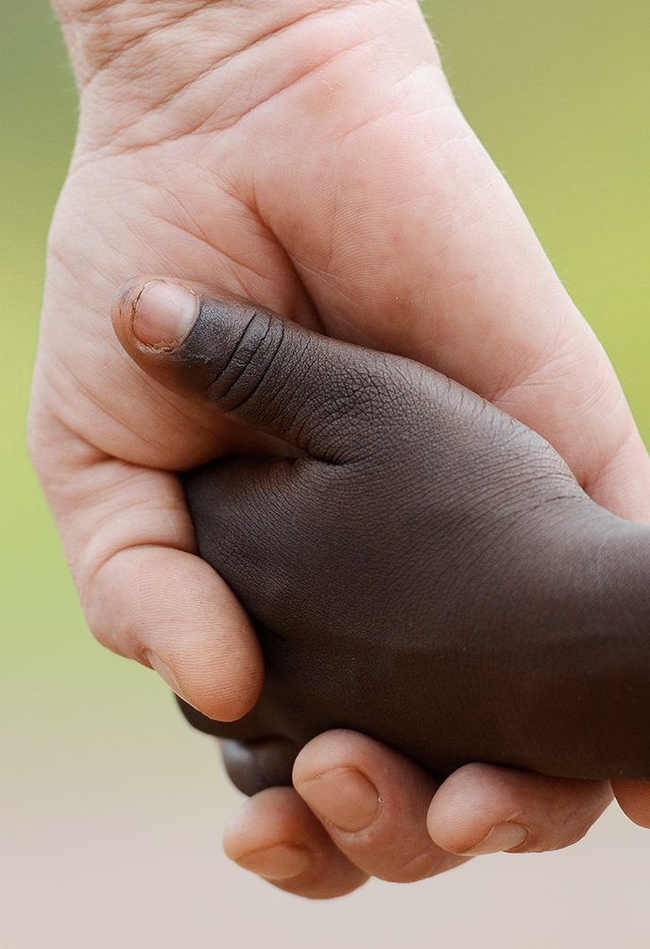
PART II
Paul the Missionary
DAY 5

Slide 19

PART III
Advantages of being
self-supported
DAY 5

Slide 20


Slide 21

PART I
Occasional and
Daily Rest
DAY 6

Slide 22

PART II
The Weekly Rest
DAY 6

Slide 23
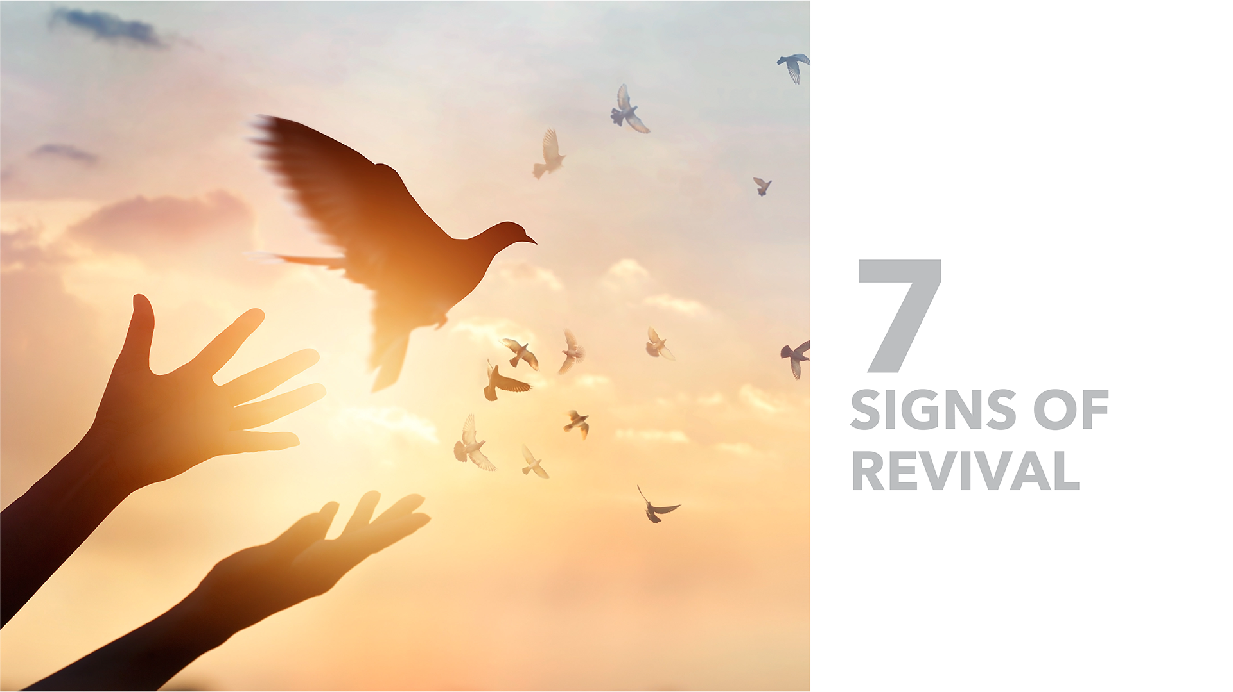

Slide 24

PART I
The Test in Eden
DAY 7

Slide 25

PART II
Lordship in the Bible
DAY 7

Slide 26
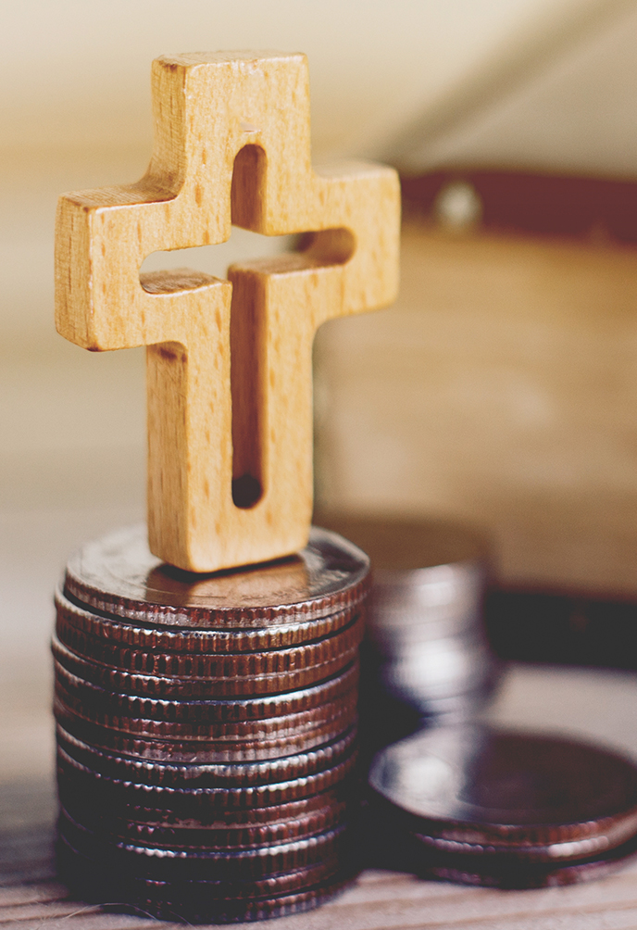
PART II
Tithing and Offerings
in the Context
of Revival and
Reformation
DAY 7

