Slide 1
On Thin Ice
Stewardship in a Postmodern Culture Stewardship in the Church Stewardship in the Bible

Slide 2
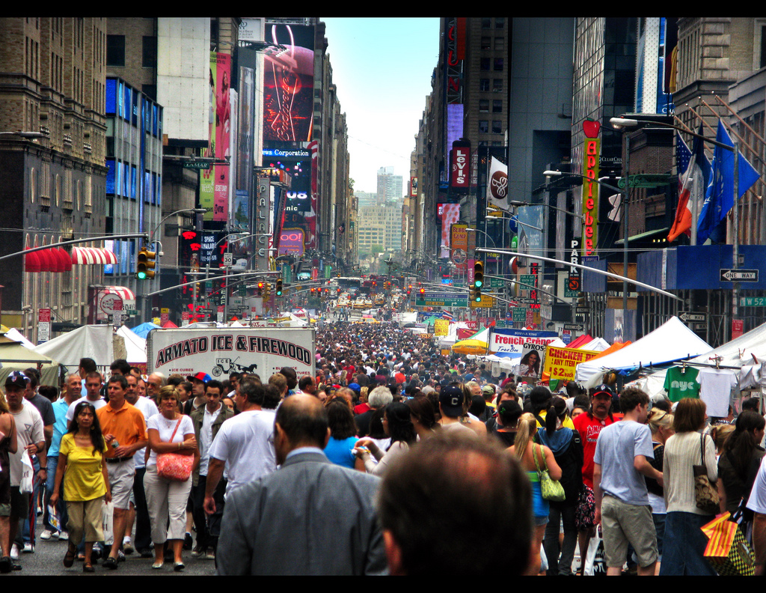
Our Postmodern Culture
We are the wealthiest nation in world history
We are saving less
We are giving less
We are the most bankrupt of any American generation
We are more stressed
We are more divorced
America owes more than the rest of the world combined.
Poor planning, priorities, Out of control finances

Slide 3
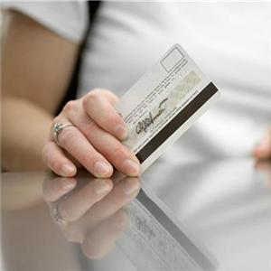
Our Postmodern Spending
More Barbie dolls in the U.S. than people.
There are not enough harbor slips for all the boats in the U.S.
$705 billion spent in 2004 on entertainment and recreation.
Americans spent $9.9 billion on soft drinks in 2007.

Slide 4
Our Postmodern Spending
1980 avg. US home was 2,000 sq. ft.
2006 avg. US home was 2,459 sq. ft.
During same period, family sizes shrank.
Storage units are the fastest growing industry in the US.
In 2007, credit card issuers imposed $18.1 billion in penalty fees. This accounts for half of the $40.7 billion profits.

Slide 5
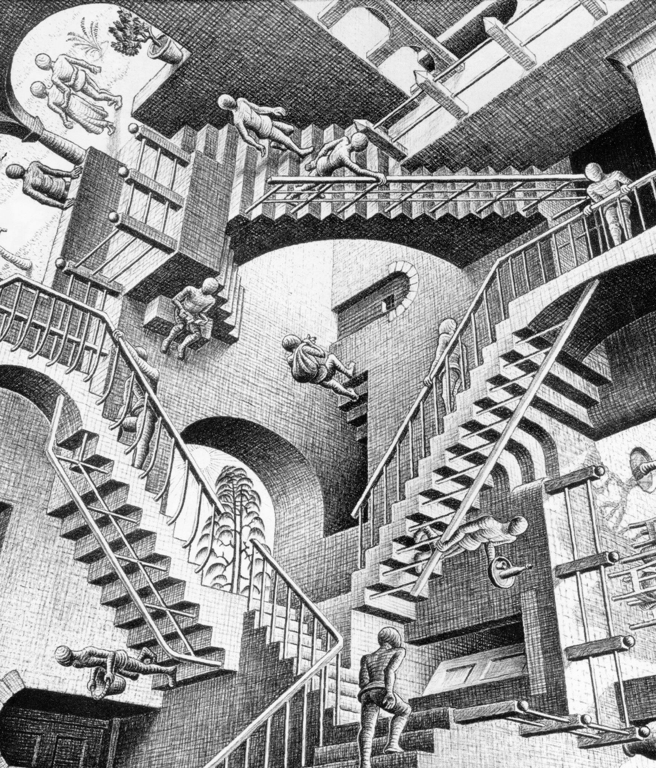
What is Postmodern Culture?
Enlightenment thinking had final authorities–God, government, science and reason. Reason was the source of authority.
Modern culture rejected enlightenment thinking, rejecting final authorities.
Postmodern culture is a “concept…characterized by distrust of theories and ideologies and by the drawing of attention to conventions” —Compact Oxford English Dictionary

Slide 6
Dr. Albert Mohler
“The postmodernists reject both the Christian and modernist approaches to the question of truth. According to postmodern theory, truth is not universal, is not objective or absolute and cannot be determined by a commonly accepted method…truth is socially constructed, plural, and inaccessible to universal reason.” —“Equip” Sept. 2005, Stewardship in the Postmodern World

Slide 7
Jill M. Hudson
“No longer are the rules and principles that formerly governed society understood to be passed down through families, religious groups, or community norms. Morals, ethics, and values are created and re-created out of personal experience. Relationships become the crucibles in which values are collaboratively constructed.” —When Better Isn’t Enough: Evaluation Tools For The 21st Century Church. Published by Alban Institute.

Slide 8
Robert J. Lifton
“Those who are consistent in their beliefs, who try to live according to a specific set of principles, and who imagine that they have a single core identity are mentally ill according to postmodernist psychologists such as Robert Jay Lifton. “
—Gene Edward Veith, “A Postmodern Scandal,” World, February 21, 1998, p. 24.

Slide 9
Postmodern Stewardship
Industry pushes a rich lifestyle to middle America
Consumers are dissatisfied and discontented with what they have
Let’s take care of the earth
Share the wealth

Slide 10
Postmodern Stewardship
Giving is your business and no one else’s
Giving is whatever you want it to be.
You create your own ethics about giving
It departs from any sound point of reference or what the Bible refers to as landmarks or waymarks. (God’s Pie)

Slide 11
Stewardship in the church
God’s
Pie

Slide 12
Stewardship in the church
Church member spending is similar to that of Americans in general.
Clergy resistance
Faith and money are not connected
The Scarcity ‘Syndrome’

Slide 13
Stewardship in the church
90% of today’s churches have no stewardship plan for financial training for the church or individuals.
52% of church buildings are mortgaged
Average Christian giving is approx. 2%
85% of Pastors surveyed do not feel comfortable teaching about stewardship.

Slide 14
Stewardship in the church
There has been a more than 30-year decline in the percentage Christians give to their churches. Depending on the denomination.
As many as 35% of church attendee giving records are blank— $ 0 of recorded offerings given.

Slide 15
Stewardship in the church
The world would be transformed,
If north America multi-denominational church members average 10% giving.
World poverty would be completely eliminated.

Slide 16
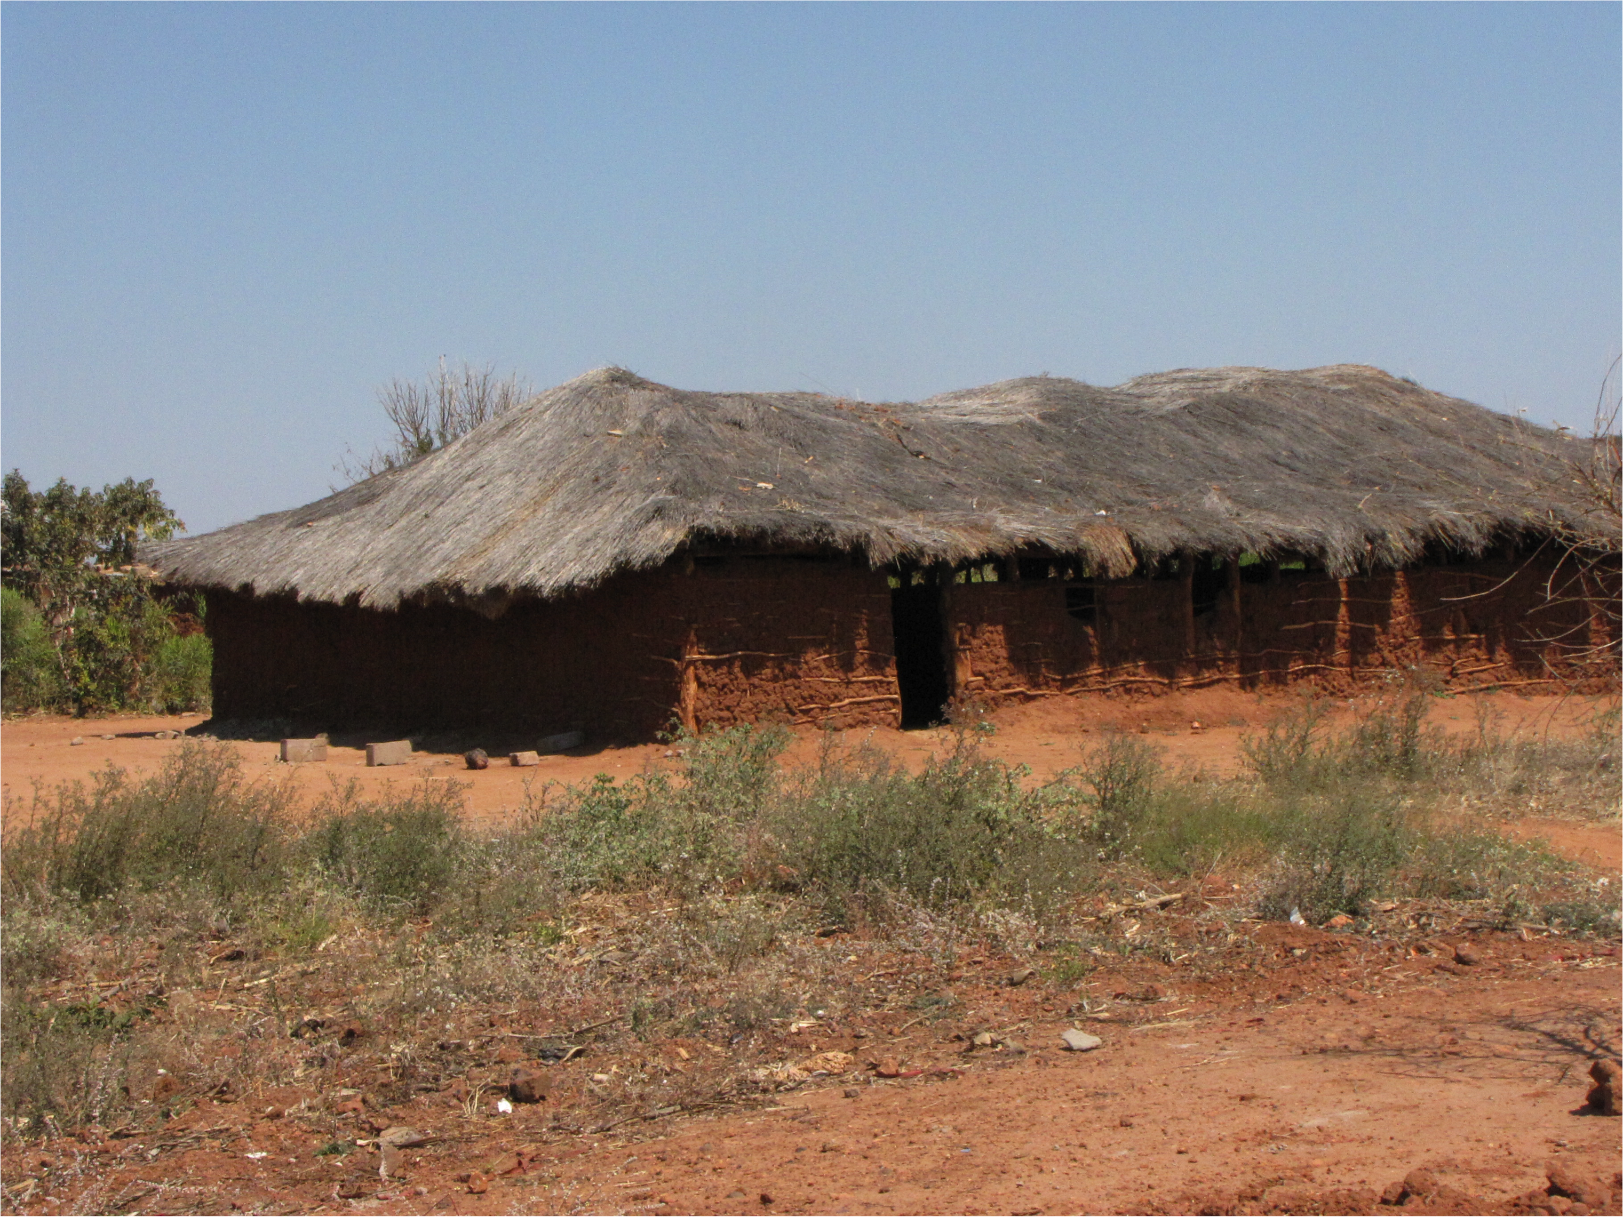
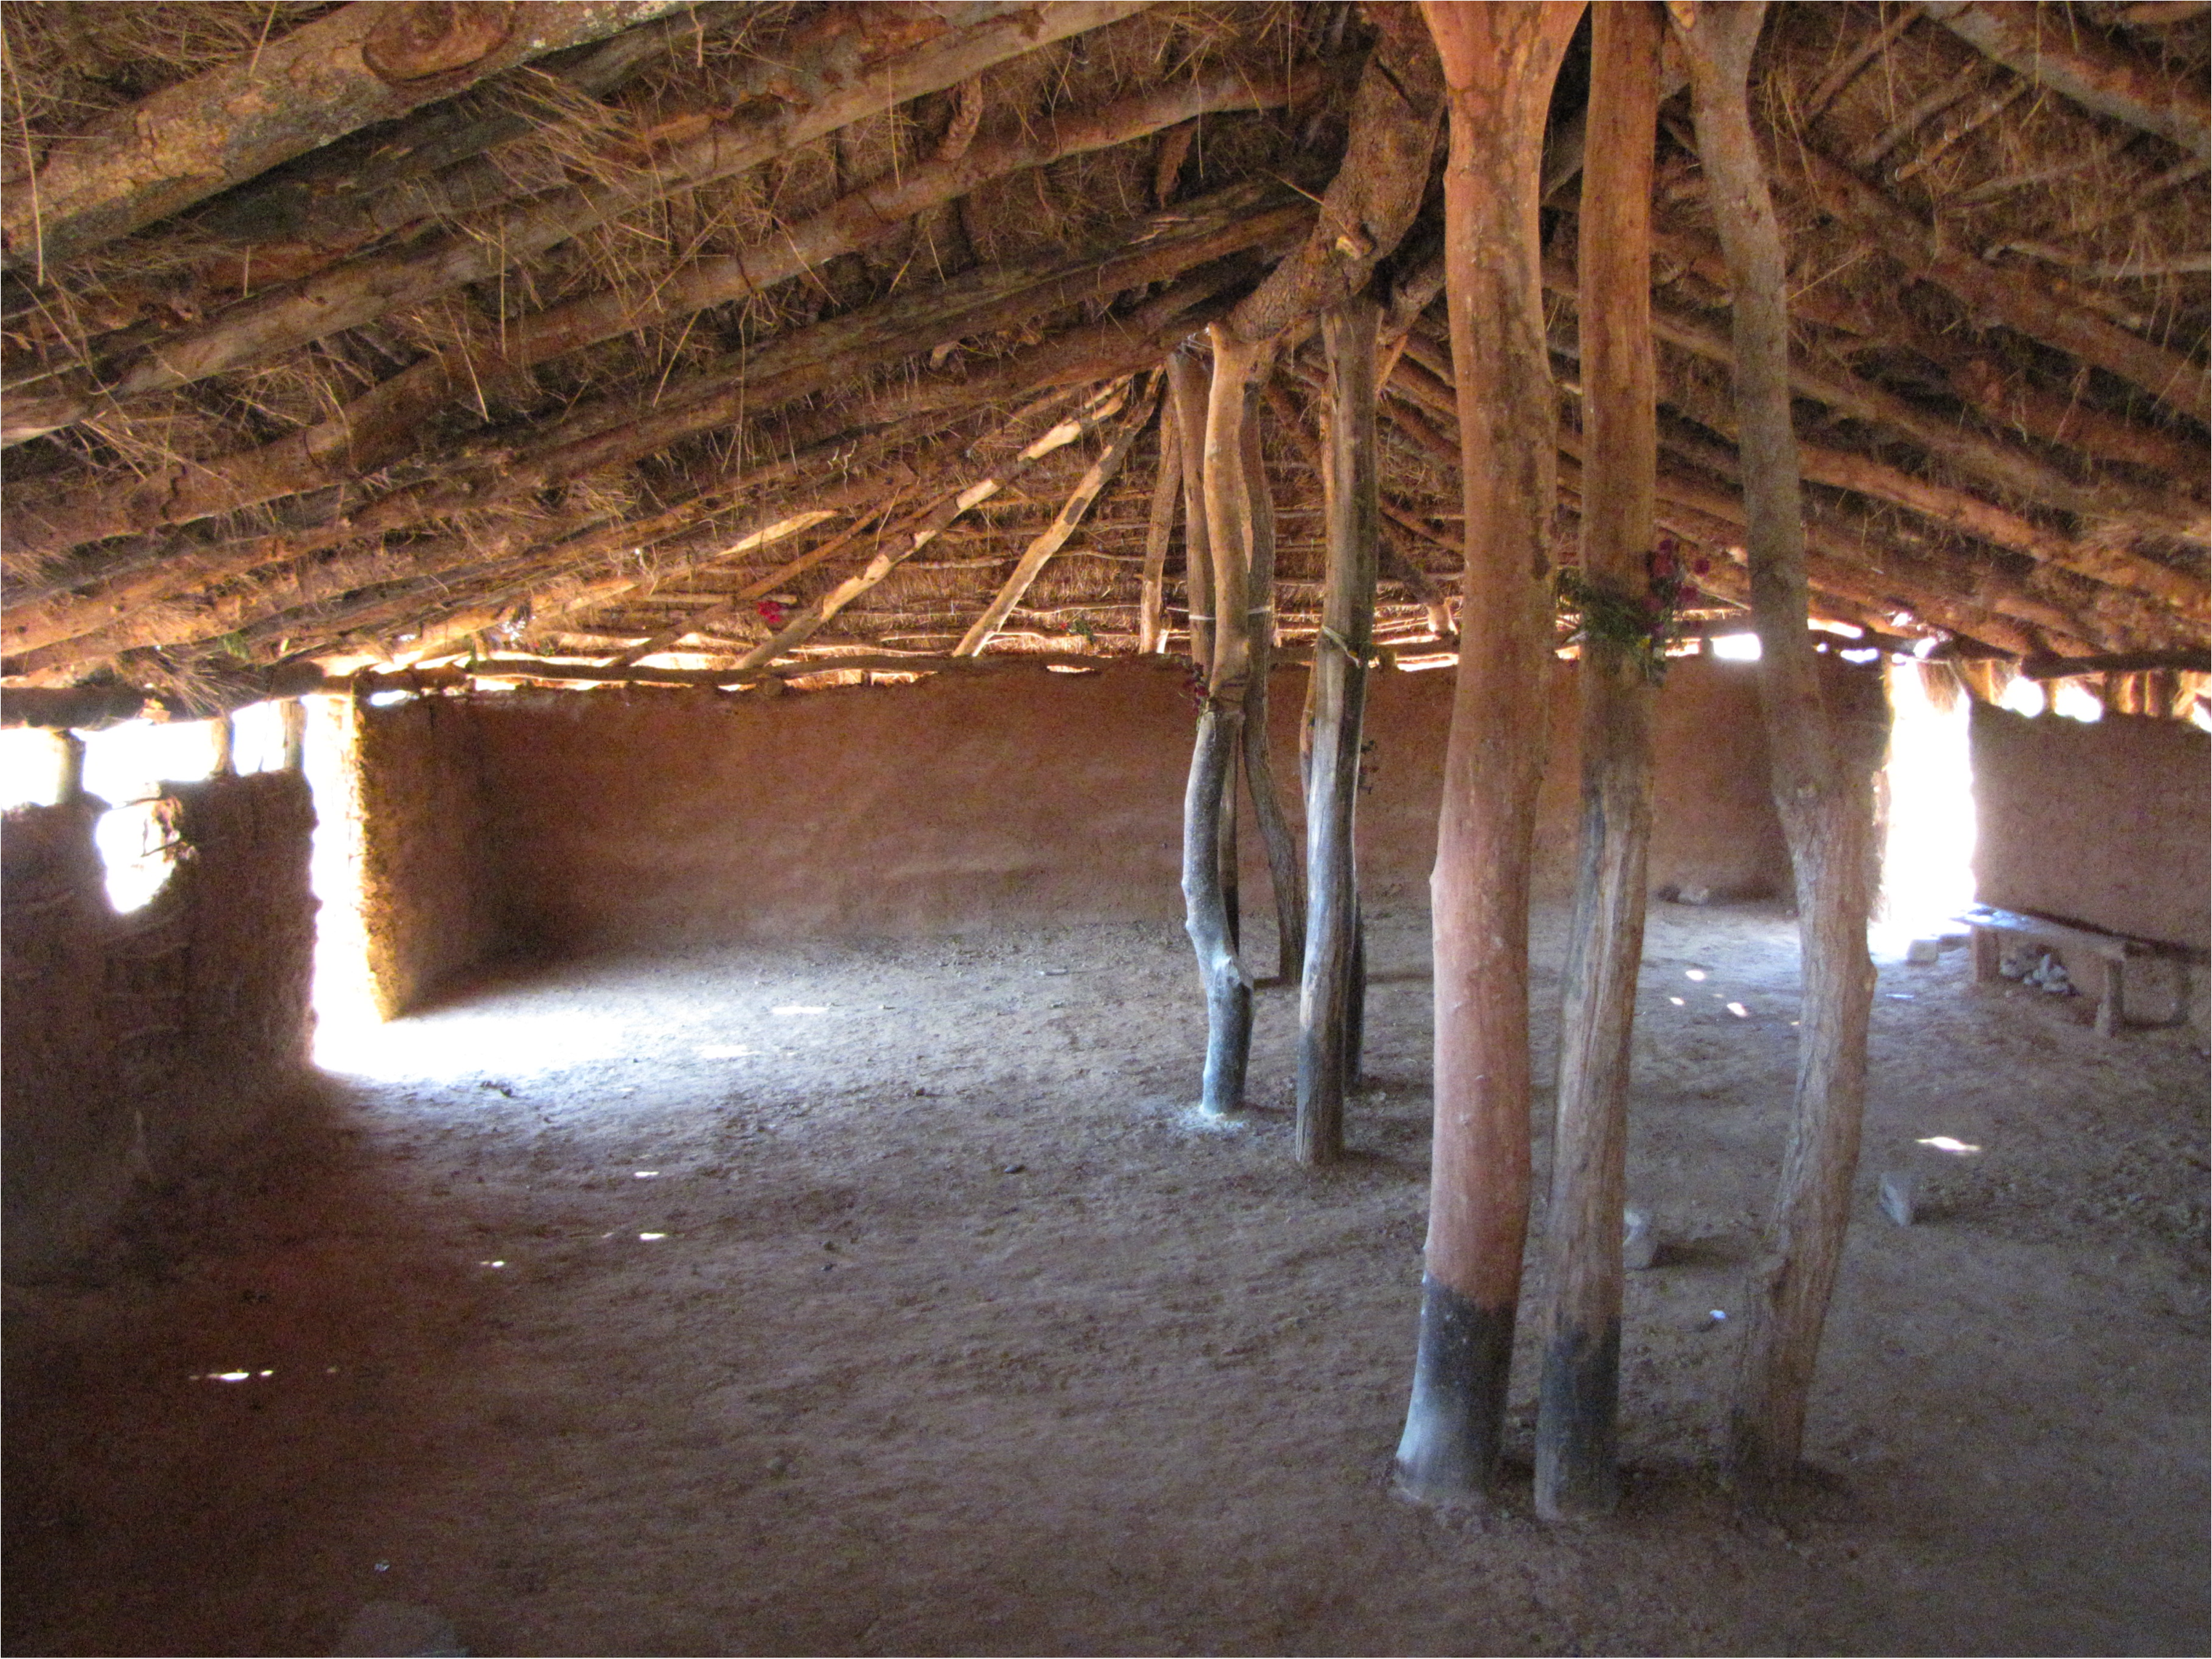
Seventh-day Adventist Church
Ngwenya, Zambia

Slide 17
Stewardship in the church
Clergy do not find satisfaction in dealing with financial matters
Money talk will alienate church members
Clergy struggle with their own finances.

Slide 18
Stewardship in the church
“The problem with many Christians today is that they are not Biblical thinkers… but merely saved humanists.” —John Camuta
Our stewardship of money looks more like Postmodern rather than a practice of Biblical stewardship of money.
We are saying one thing but do another

Slide 19
Stewardship in the Bible
God is the Owner
The earth is the LORD’S, and the fullness thereof; the world, and they that dwell therein. Ps 24:1
The silver and the gold is mine. Haggai 2:8
Every beast of the forest is mine…Ps. 50:10

Slide 20
Stewardship in the Bible
We are Stewards, managers
Moreover it is required in stewards, that a man be found faithful. 1 Cor. 4:2
We have gifts that differ according to the grace given to us: prophecy, in proportion to our faith; ministry, in ministering; the teacher, in teaching; the exhorter, in exhortation, the giver, in generosity. Romans 12:6-8

Slide 21
Stewardship in the Bible
Based on the gift they have received, everyone should use it to serve others, as good managers of the varied grace of God. 1 Peter 4: 10 (CSB)
“Stewardship is everything you do after you say, ‘Yes’ to Jesus.” —Clarence Stoughton
Justification; sanctification; stewardship is practical sanctification

Slide 22
Stewardship in the Bible
Consistent belief in absolutes
He made the church the depositary of sacred truth. He left his church a stewardship of sacred truth, and it is the work of the church to carry forward his mission of saving the world… They are to be his representatives to the world. Believing in Christ as their personal Saviour, they take up the work where he left it. "Without me ye can do nothing," said Christ; but with Him we can do all things.

Slide 23
Stewardship in the Bible
Faithfulness is the baseline
As he looked up, Jesus saw the rich putting their gifts into the temple treasury. He also saw a poor widow put in two very small copper coins. “I tell you the truth,” he said, “this poor widow has put in more than all the others. All these people gave their gifts out of their wealth; but she out of her poverty put in all she had to live on. Luke 21:1–4 (NIV)

Slide 24
Stewardship in the Bible
Widow gave all she had
Widow gave passionately
Widow gave out of love for the cause
Widow gave to support God’s work
Widow gave in a hurry, quickly, recklessly
Widow gave sacrificially
Widow gave more than anybody else

Slide 25
Stewardship in the Bible
The widow's mite has been like a tiny stream flowing down through the ages, widening and deepening in its course, and contributing in a thousand directions to the extension of the truth and the relief of the needy. The influence of that small gift has acted and reacted upon thousands of

Slide 26
Stewardship in the Bible
hearts in every age and in every country. As the result, unnumbered gifts have flowed into the treasury of the Lord from the liberal, self-denying poor. Her example has stimulated to good works thousands of ease-loving, selfish, and doubting ones, and their gifts also have gone to swell the value of her offering.--Signs, Nov. 15, 1910.

Slide 27
Stewardship in the Bible
It is the motive that gives character to our acts, stamping them with ignominy or with high moral worth. Not the great things which every eye sees and every tongue praises does God account most precious. The little duties cheerfully done, the little gifts which make no show,

Slide 28
Stewardship in the Bible
and which to human eyes may appear worthless, often stand highest in His sight. A heart of faith and love is dearer to God than the most costly gift. Counsels on Stewardship, p. 175-176.
There are three conversions; the heart, the mind and money. Martin Luther

