Slide 1
P
artnership
with Jesus
BY PR. Benjamin
C. Maxson

Slide 2
What differentiates duty from ministry?

Slide 3
Betty was tired of being the Kindergarten leader for twenty-five years but she kept going back. As she trained someone to replace her, she realized that God wanted her in this department and not because no one else would do it.

Slide 4
What made the difference? Twenty-five years in a job before it became ministry! Twenty-five years of doing something for secondary, though important, reasons.

Slide 5
What differentiates ministry from duty or task?

Slide 6
As a twelve-year old boy He learned about, My Father’s business. He dedicated his entire life to serving others, and His service came to a focus in the last three years of concentrated ministry.

Slide 7
The following four key factors marking Jesus’ life and service can also be ours.

Slide 8
Divine Calling—the Christian, by identity, is called to ministry.

Slide 9
Jesus’ life modeled this call: The Son of Man did not come to be served, but to serve, and to give his life as a ransom for many (Matt. 20:28).

Slide 10
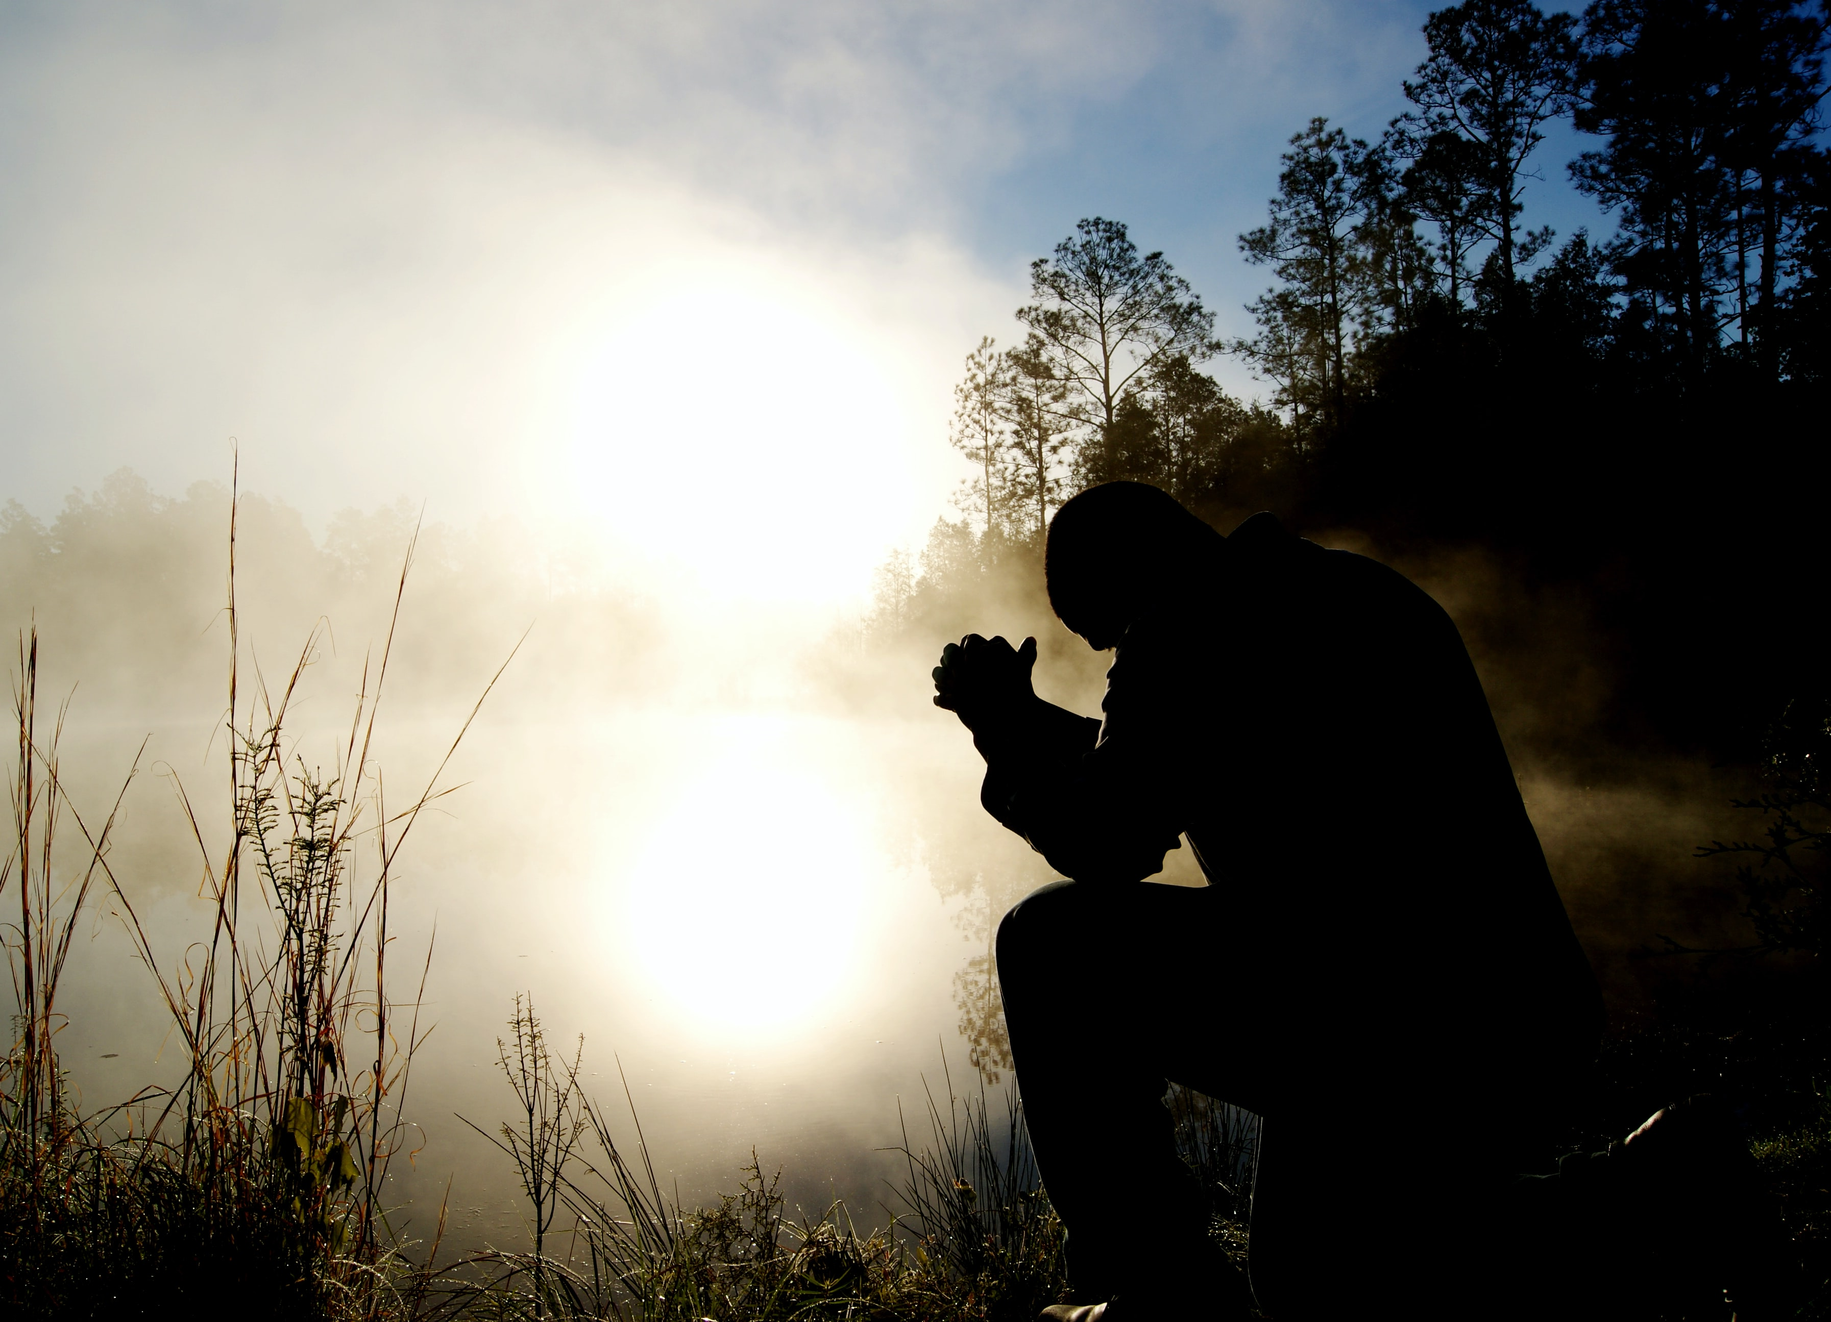
We are called to participate in Christ’s ministry of reconciliation (2 Cor. 5:14-21). He declares that God gave us the ministry and word of reconciliation.

Slide 11
The primary purpose of the pastoral gift: to prepare God’s people for works of service (ministry), so that the body of Christ may be built up (Eph. 4:12).

Slide 12
We are called to active ministry—to be players on the field, not pew spectators.

Slide 13
God calls each one of us to a specific personal ministry within the broader focus. Discovering that call marks the beginning of a thrilling journey of service in His kingdom.

Slide 14
Divine Equipping—God equips us for our ministry with specific gifts (Rom. 12:1-8; 1 Cor. 12-14; Eph. 4:1-16) and promised power (Matt. 28:20). These gifts are not for personal benefit but for the good of the body (1 Cor. 12:7).

Slide 15
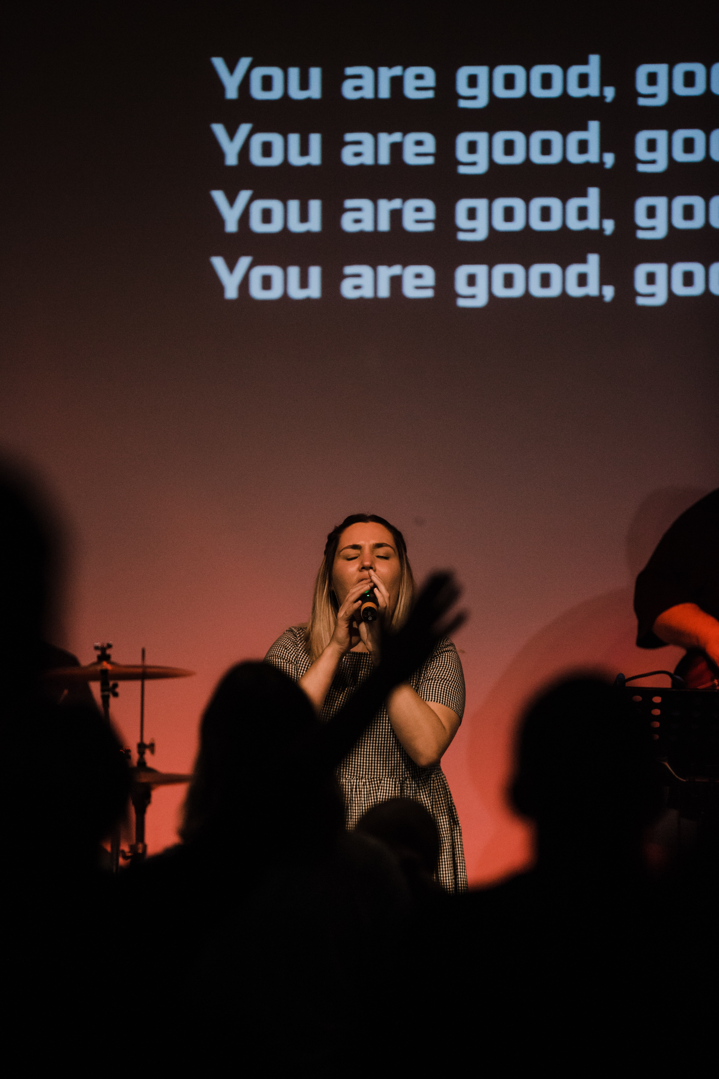
God is the one who determines the gifts we receive (v 11). These gifts work together within the body of Christ in the same way different parts of our physical bodies work together.

Slide 16
Identifying the unique gifts God gives to us individually is a determining factor in discovering our specific personal call to ministry. Ministering within our area of giftedness is one of the secrets of rewarding service.

Slide 17
Divine Presence—God does not ask us to work alone. The reality of God’s presence is at the very core of ministry.

Slide 18
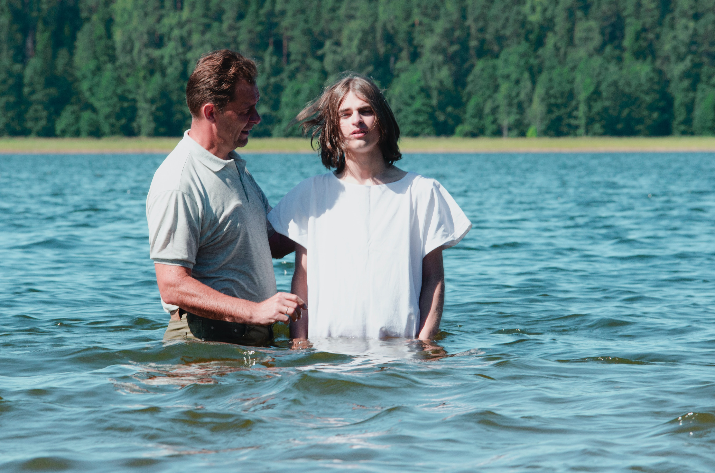
Jesus presents His over-arching call of making disciples in the context of His power and promised presence (Matt. 28:18-20). The Holy Spirit transforms us with Christ’s presence (Eph. 3:15-19).

Slide 19
Without the awareness of His presence, ministry can quickly lose its sense of divine calling or deteriorate into drudgery. As we bring Christ’s presence and power into the lives of those we touch, our service becomes an extension of His ministry.

Slide 20
Focused Ministry—Maintaining our focus is a challenge in our ministry.

Slide 21
Jesus maintained a very clear focus. He knew His target audience, adapted His ministry to diverse groups and never forgot the primary purpose of His work.

Slide 22
Christ’s ministry was multi-leveled. His ministry to the multitudes focused on inspiring and calling them to a higher life—a life centered in God. His ministry to the seventy was centered on discipling and commissioning them for ministry.

Slide 23
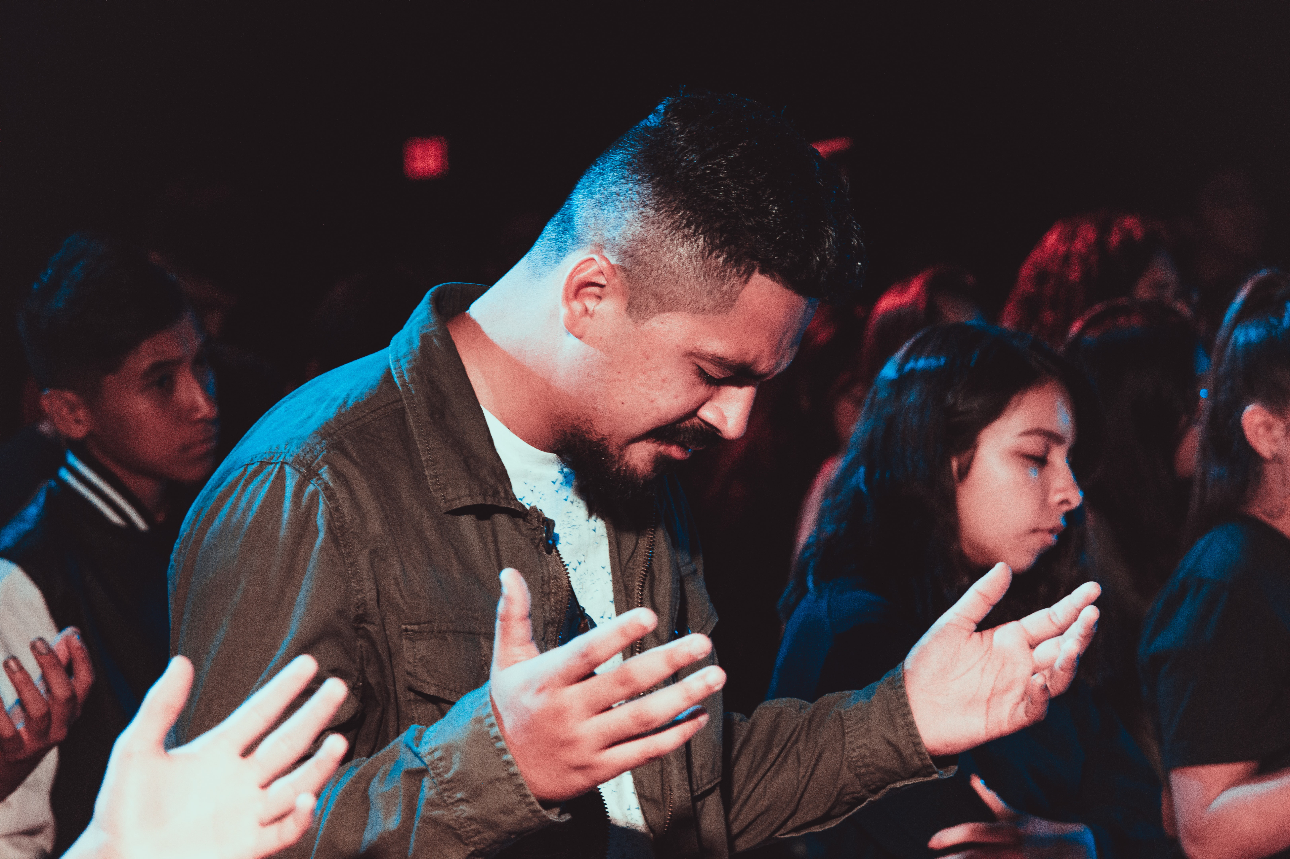
His focus sharpened even more as He concentrated on the twelve—discipling and fashioning them as spiritual leaders. Within those twelve, He chose three whom He mentored.

Slide 24
The focus of Christ’s ministry was forged by His sense of calling and designed to meet the specific needs of the group.

Slide 25
As we explore the focus of our ministry, we need to concentrate on the key purpose of ministry—making disciples. This is the general call to ministry within the body of Christ (Matt. 28:18-20).

Slide 26
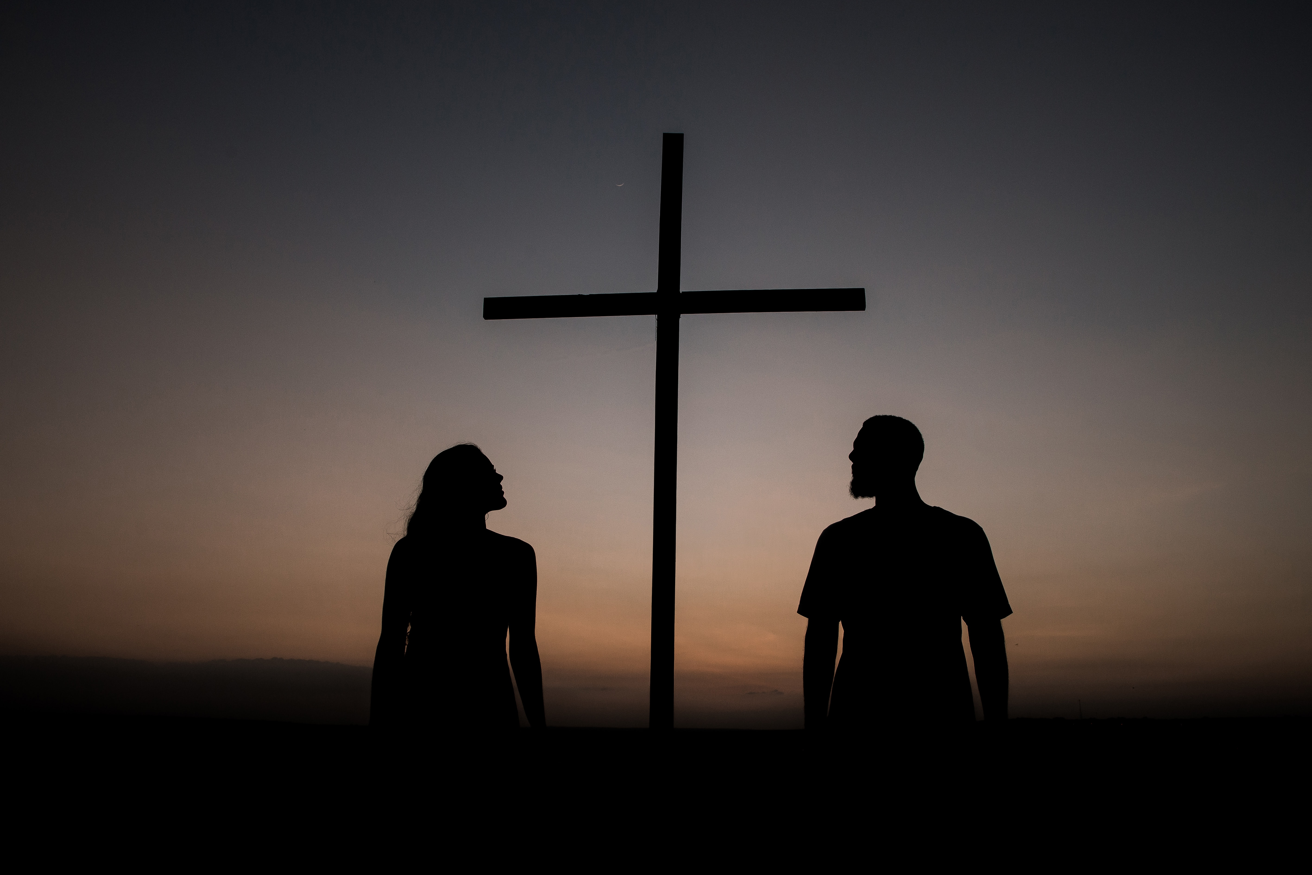
While our individual calling may have a narrower focus, we must remember that all ministry finds its ultimate purpose in his Gospel commission. The Holy Spirit creates the new birth experience in our life, then God trusts us to fashion that life into a disciple who is walking with Him.

Slide 27
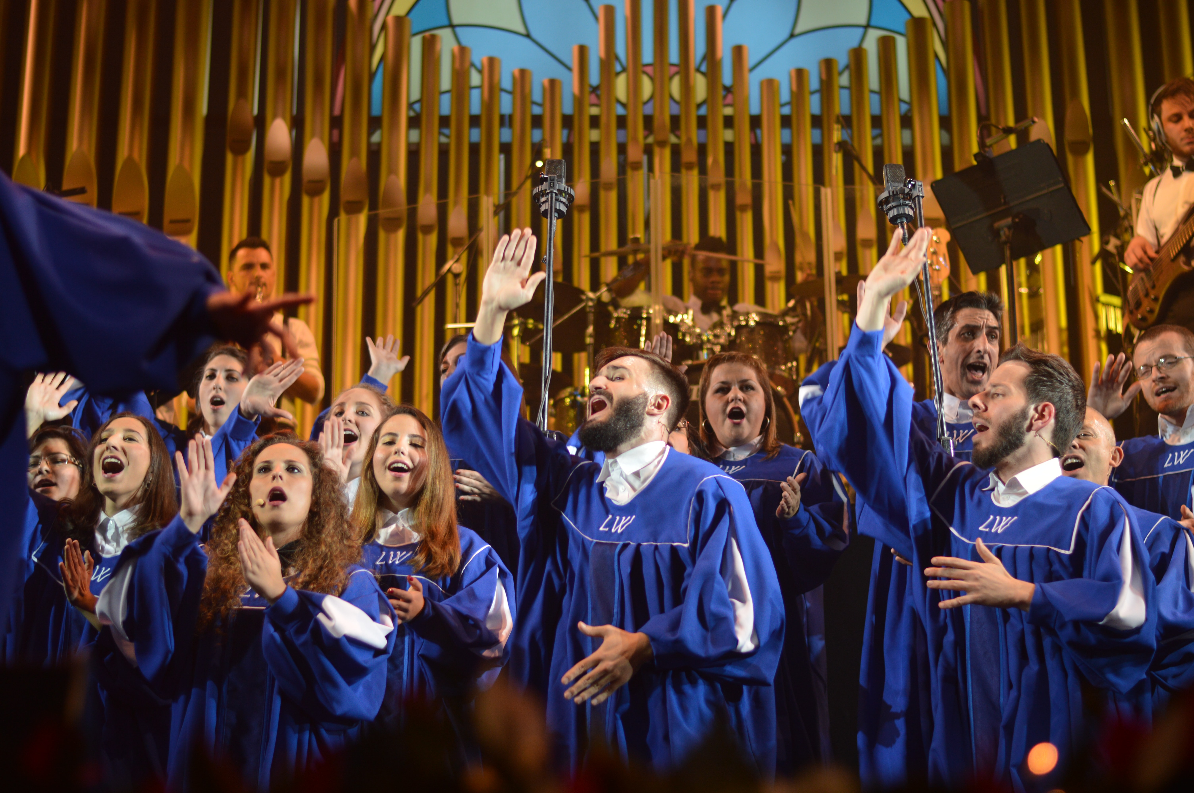
Thus ministry becomes a life of service—worship (Rom. 12:1). It means using the gifts God has given us to extend His grace to those around us.

Slide 28
God made us for relationship with Him. Christ’s reconciling death resolves sin’s interruption in that relationship. He then invites us to partner with Him in His ministry.

Slide 29
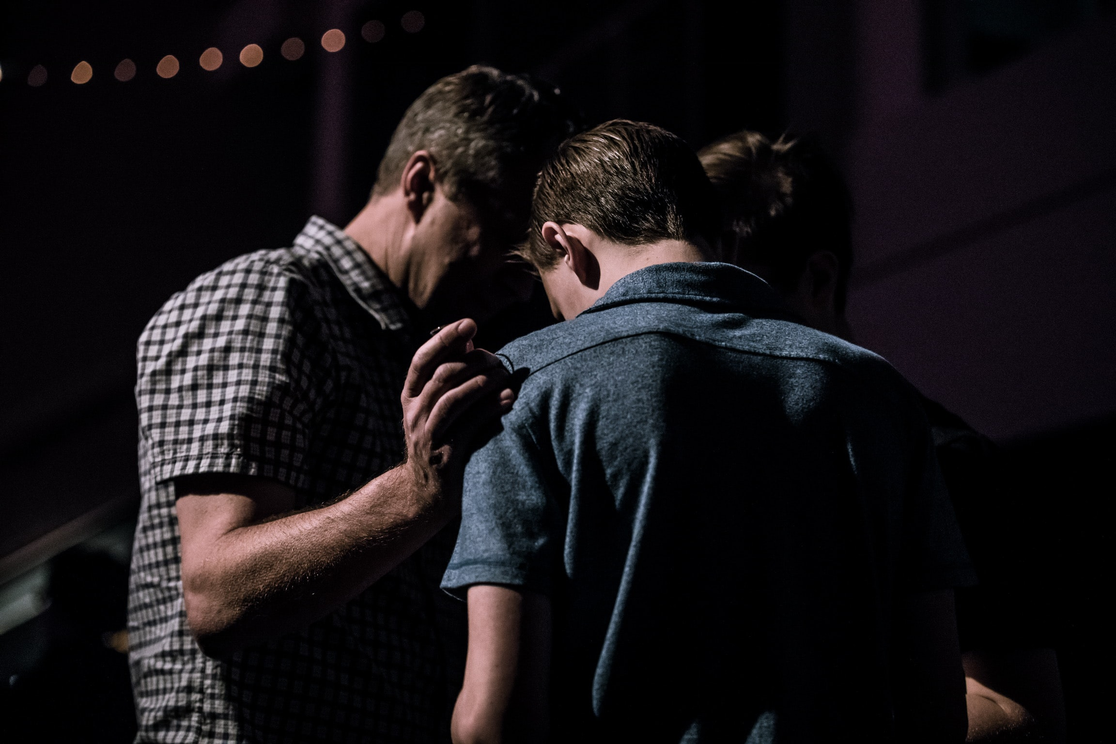
Our challenge is to identify our specific calling and use the gifts he has given us. Identifying our spiritual gifts helps us identify our calling and focus.

Slide 30
He invites us to live in His presence—actively bringing others into the experience of His grace—as partners in ministry.

