Slide 1
T
he Most needed
Kind of Offering
Part 1
by Marcos F. Bomfim

Slide 2
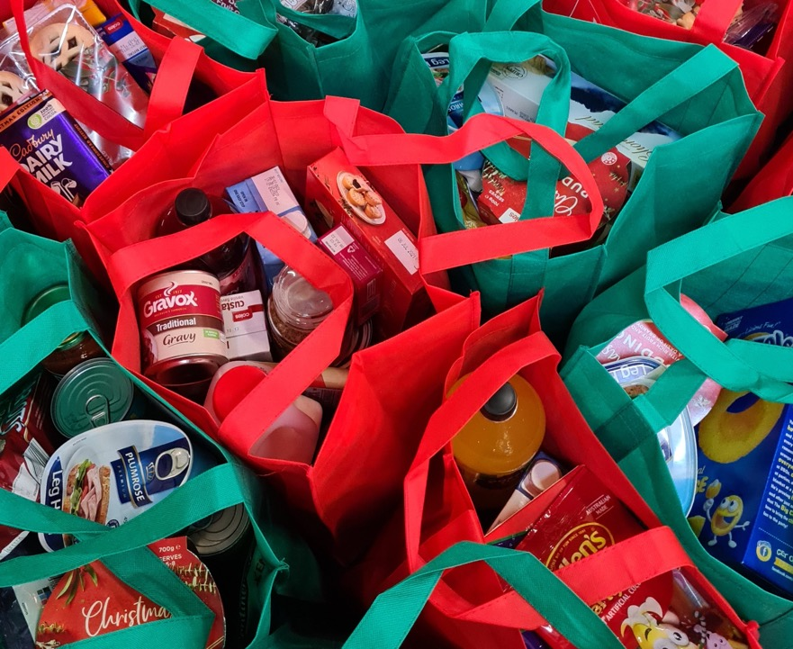
Edward, a committed fellow member in my church in Maryland (USA) said, "I am using my offerings to fund a food bank initiative in a poor country, and every food bag also receives a missionary book."

Slide 3
Nelson, a friend and fellow pastor working in a developing country, told me that he is keeping his offerings in a special bank account, waiting for the best project for which to use them.

Slide 4
What is the most efficient way to give, use, or distribute “my” offerings?

Slide 5
Why is it important to give offerings if I am already tithing? Why are offerings important in the end-time context?

Slide 6
Should we bring regular and systematic offerings to the storehouse, as we do with the tithe?

Slide 7
If the offerings really belong to God, and not to me, is it right for me to decide how to distribute them, or are there some divine directives as to how I distribute those funds?

Slide 8
WHY SHOULD I GIVE
OFFERINGS IF I AM
ALREADY TITHING?

Slide 9
Reasons why offerings should be considered as important as tithe.

Slide 10
1.
God requires and expects offerings just as He does tithe. According to the Bible, both are equally required and expected by God, and the fact that I am bringing one of them will never exempt me from the other (Mal. 3:8).

Slide 11
“This matter of giving is not left to impulse. God has given us definite instruction in regard to it. He has specified tithes and offerings as the measure of our obligation. And He desires us to give regularly and systematically” (Ellen G. White, Counsels on Stewardship [Washington, D.C.: Review and Herald Pub. Assn., 1940], pp. 80, 81; see also pp. 36, 52, 67, 68, 73, 75, 77, 84-86, 258).

Slide 12
2.
Offerings are an expression of recognition and gratitude. David said that all things, including my income or increase, come from God, and it should be from these that I should take my offerings (1 Chron. 29:14), as well as the tithe.

Slide 13
I am supposed to bring to Him the first fruits (the first and/or the best part) of all my increase (Prov. 3:9), to demonstrate my recognition that He is the source of all that I have.

Slide 14
3.
Offerings require a more complex decision process than the tithe. To give the tithe, I need only to decide if I will comply or not with God’s clear instructions about the subject (regularity, proportion, where to bring it, and how it should be used).

Slide 15
But when it comes to offerings, there is an additional choice that is not necessary when I tithe, and it is about how much I will give. See GC Working Policy (2019-2020), V14.

Slide 17
4.
Offerings can accomplish all that the tithe cannot. Even though the tithe is a very important resource, it is also very restricted and limited in its use. It can be used only as prescribed by God (see infographic 1): for the maintenance of those who are appointed, accredited, and paid by the church to preach the gospel and their support teams (Num. 18:21, 24).

Slide 18
Offerings are considered as unrestricted and can be used to support almost all other expenses related to missionary work around the world!

Slide 19
Offerings currently represent only about 30 percent of the Seventh-day Adventist Church finances!

Slide 20
Imagine how much more we could do if offerings could be increased. We could expedite Jesus’ mandate to preach the gospel of the kingdom, not only locally, or where we believe it should be preached, but “in all the world as a witness to all the nations” (Matt. 24:14, NKJV).

Slide 21
Although the Lord must be praised for what has already been accomplished in the mission it is still too little compared to what we have been commanded to do.

Slide 22
The fields are ripe; the time is short, and the need for resources are many. Who are the laborers that will come to the help of the Lord, investing in a coordinated way to save souls? I will go!

Slide 23
For more about the use of tithe, see Ellen G. White, Counsels on Stewardship, pp. 101-103, and Angel M. Rodriguez, Stewardship Roots—Toward a Theology of Stewardship, pp. 45, 54, 55.

Slide 24
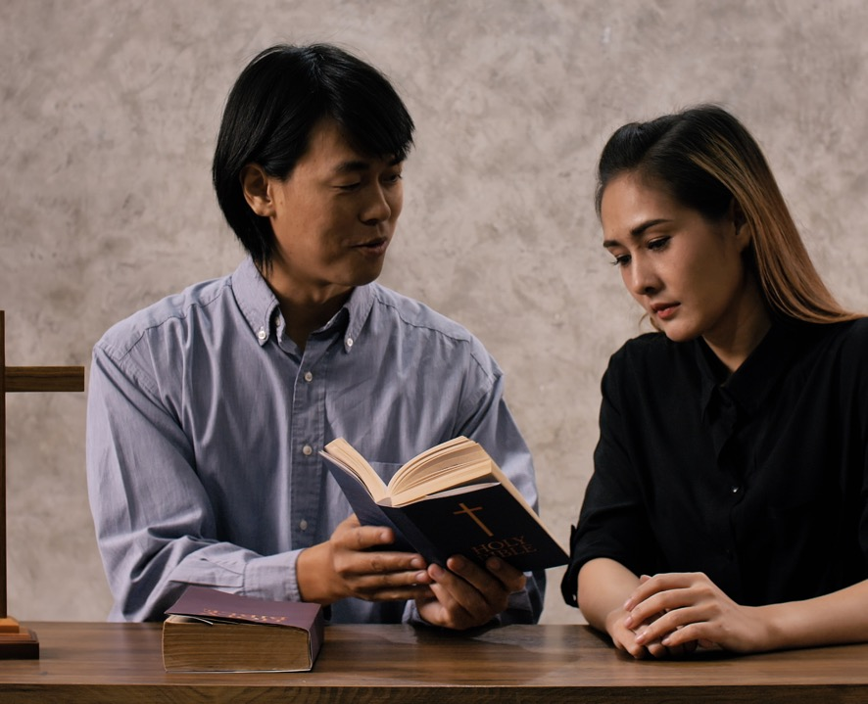
Missionary projects or initiatives partially or entirely supported by offerings.

Slide 26
“Established work’ exists in a country or area of the world when one or more of the following criteria have been met: (1) when an organized church meets regularly; (2) when a mission station, health-care facility, or school is functioning regularly; or (3) when a regular full-time denominational employee is based in the country or area carrying on outreach or soul-winning activities through such units as a Sabbath school, an organized company, or a language school.

Slide 28
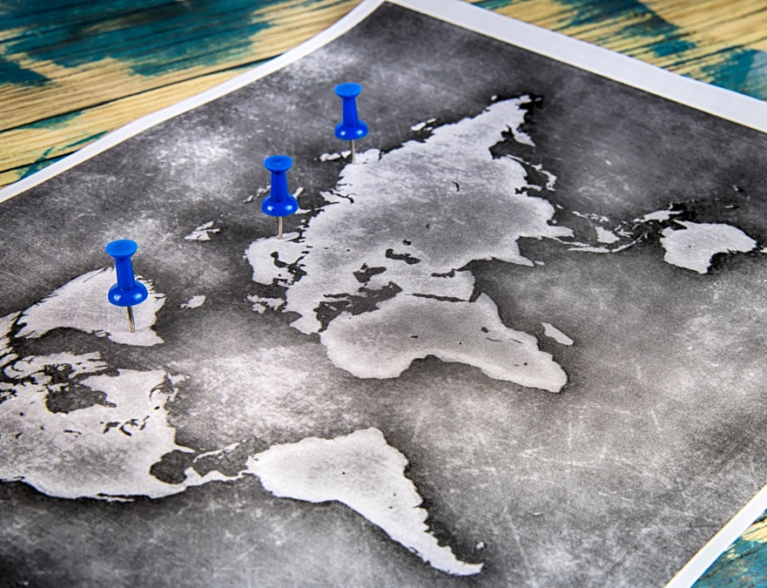
Seventh-day Adventist work is not considered to be established in a country or area when it is limited to a series of evangelistic meetings, literature evangelist work not based there, scattered Sabbathkeepers, employees traveling through, or temporary service by regular employees, student missionaries, or other volunteer employees” (“Report of the General Conference of Seventh-day Adventists’ 2019 Statistics,” 2020 Annual Statistical Report, vol. 2, p. 100).

Slide 30
Part 1
The Most
Needed Kind
of Offering

